Slide 1
THE SCIENCE BEHIND TV!
WHAT GOES ON BEHIND THE SCREEN
BY CHELSEA ST. CYR

Slide 2
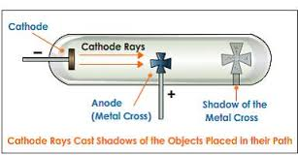
IN BREAKING NEWS…
We’ve discovered how it works!
Cathode Ray Tube
Vacuum tube
Beam of electrons
Brought to you by ©electric fields

Slide 3
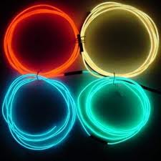
PHOSPOR AND MAGNETISM
Phosphor
On the screen
Glows when struck by electrons
Magnetism
No magnetism = no expansion
Illumination would only hit the center
Stay right there!
New episode of “Solution” is up next!

Slide 4
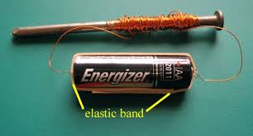
THE DIRECTION OF BEAMS
Illuminates entire screen
Changed by two electromagnets
Horizontally
Vertically
Change the direction of the current
→ change the direction of the beam

Slide 5
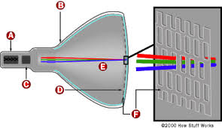
COLOR TELEVISION
3 colors of phosphor
Red
Green
Blue
One beam for each color
Scan over the screen
LETTER | MEANING
A | CATHODE
B | CONDUCTIVE COATING
C | ANODE
D | PHOSPHOR-COATED SCREEN
E | SHADOW MASK

